Slide 1

CalorieMate
By Team 3 - The Innovators

Slide 2
Agenda
Team Member Roles and Responsibilities
Problem Statement
Project Description
User Personas
Technologies
Algorithms
Project Schedule
Team Working Agreement
Retrospective
Group Wikipage Link

Slide 3
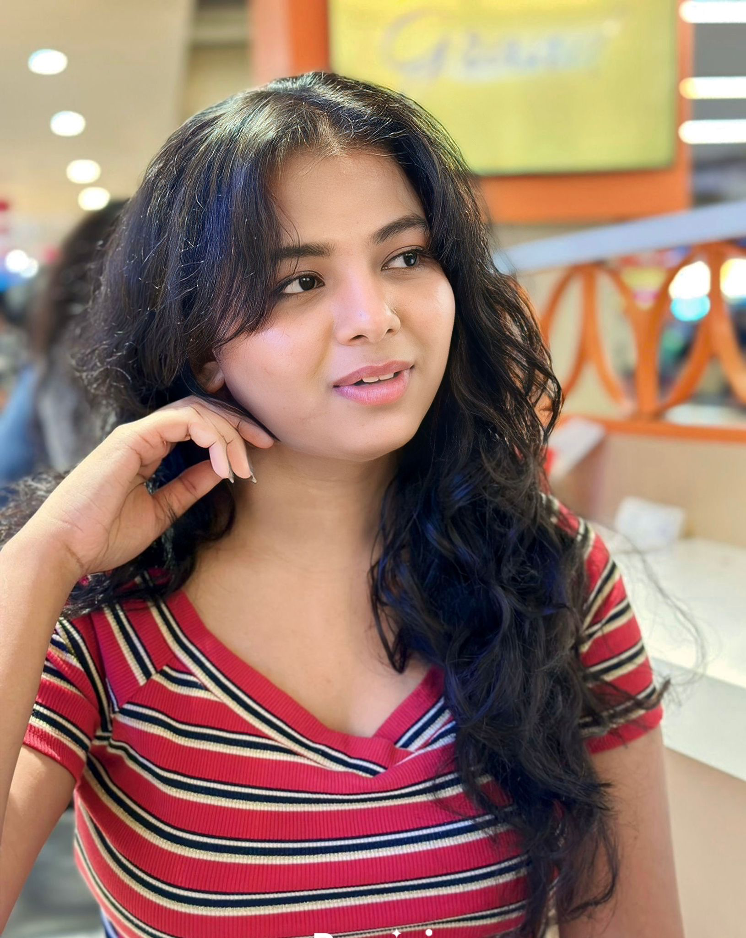

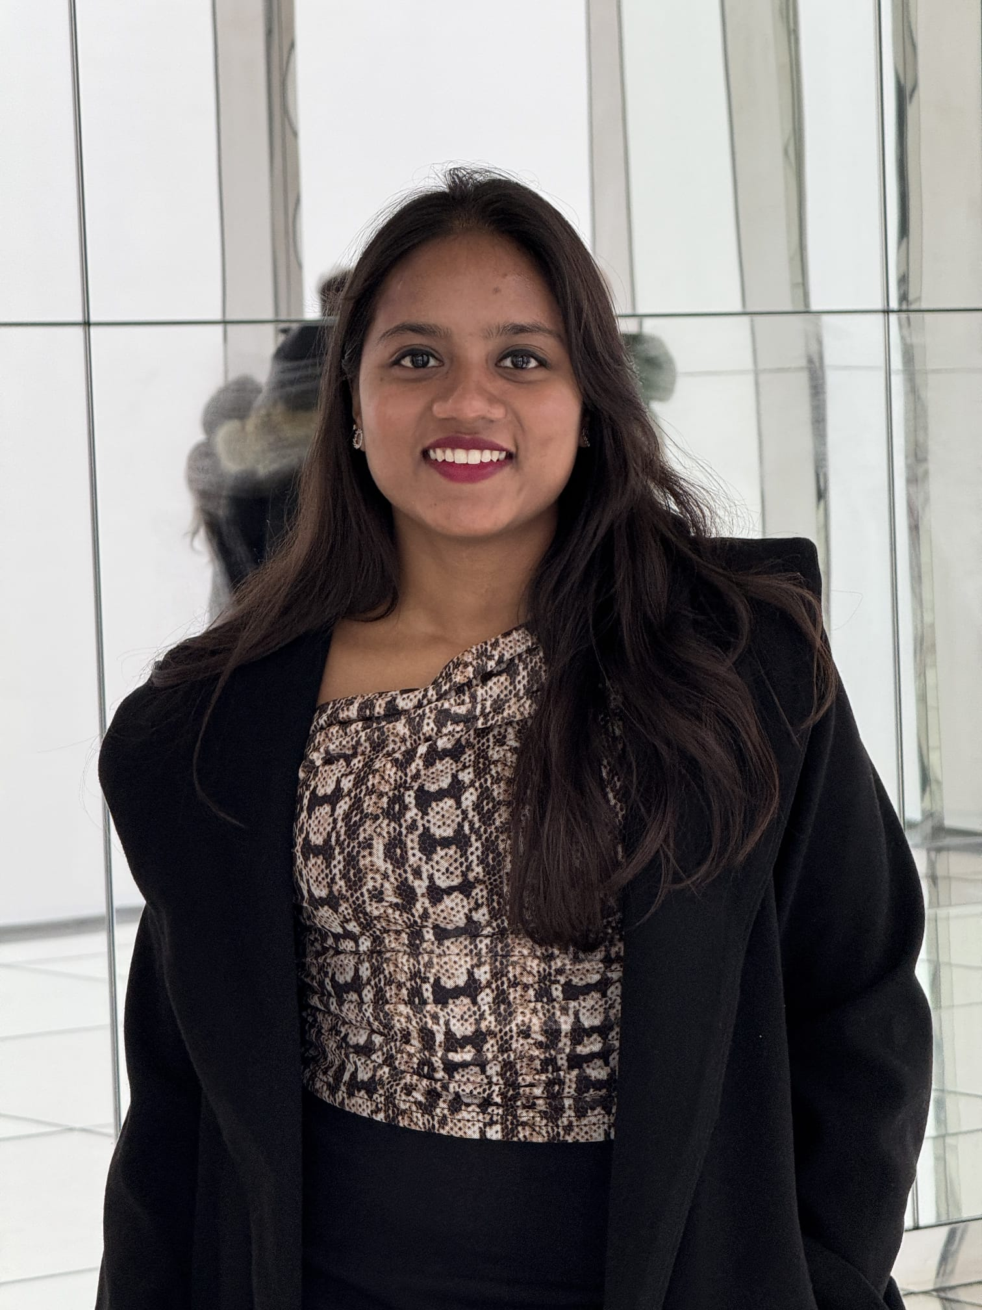
Team Member Roles and Responsibilities
Ranjitha Durgasi – Frontend Developer- Team Leader
Nikhitha Reddy Nallanagula – Frontend Developer
Harshitha Korapati Murali – Backend Developer

Slide 4

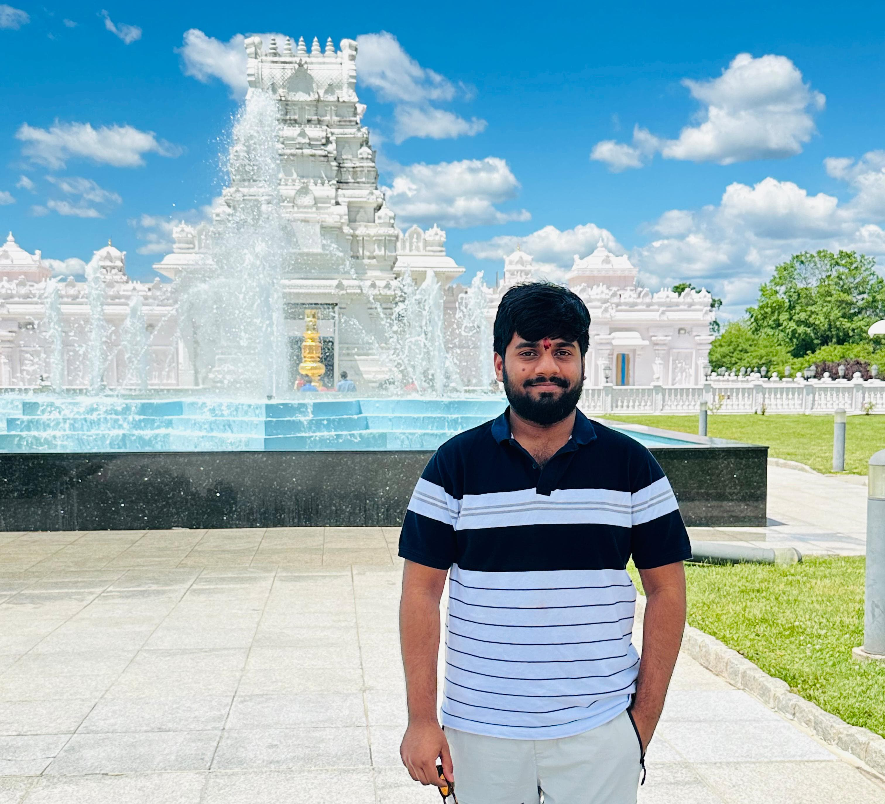
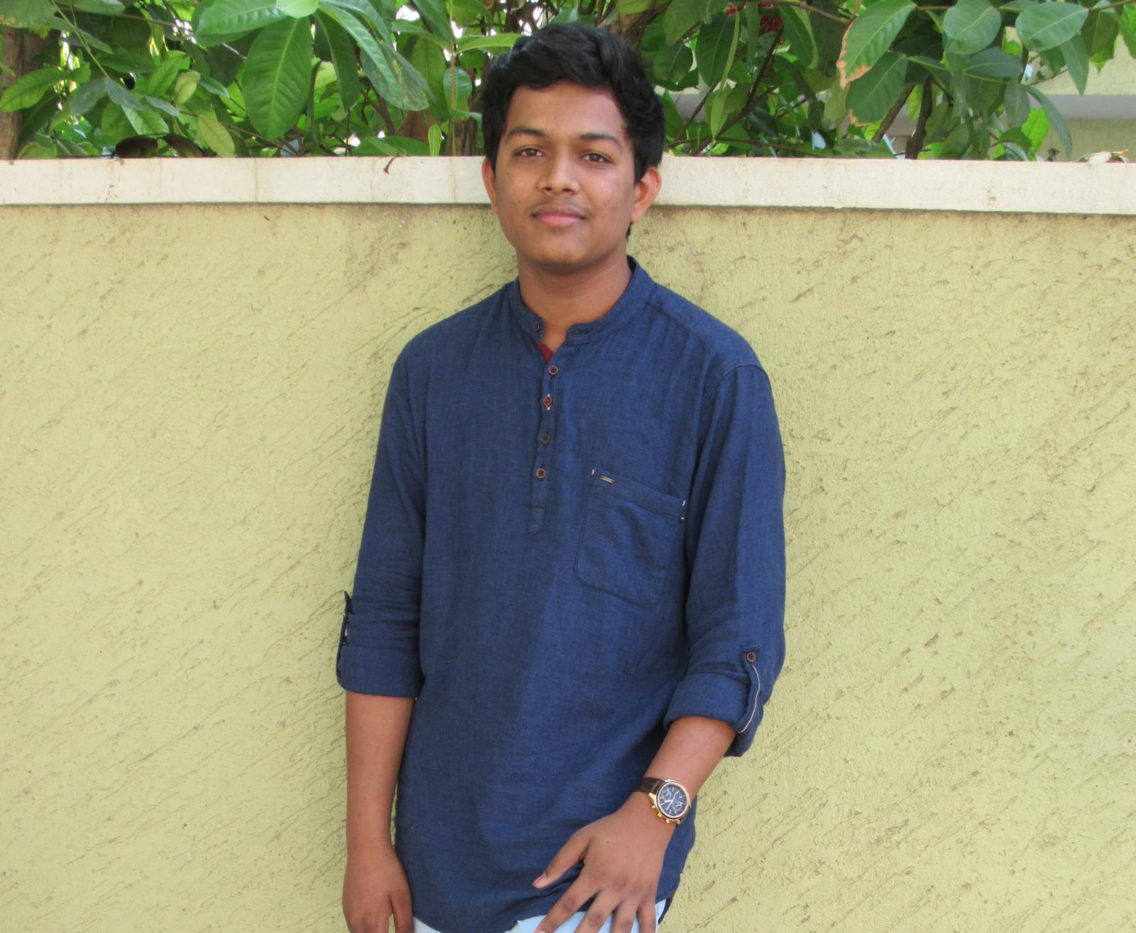
Team Member Roles and Responsibilities
Sai Bhargav Ram Koduru – Backend Developer
Saikumar Gone – Machine Learning Engineer- Scrum Master
Kariveda Vikranth Reddy – Machine Learning Engineer

Slide 5
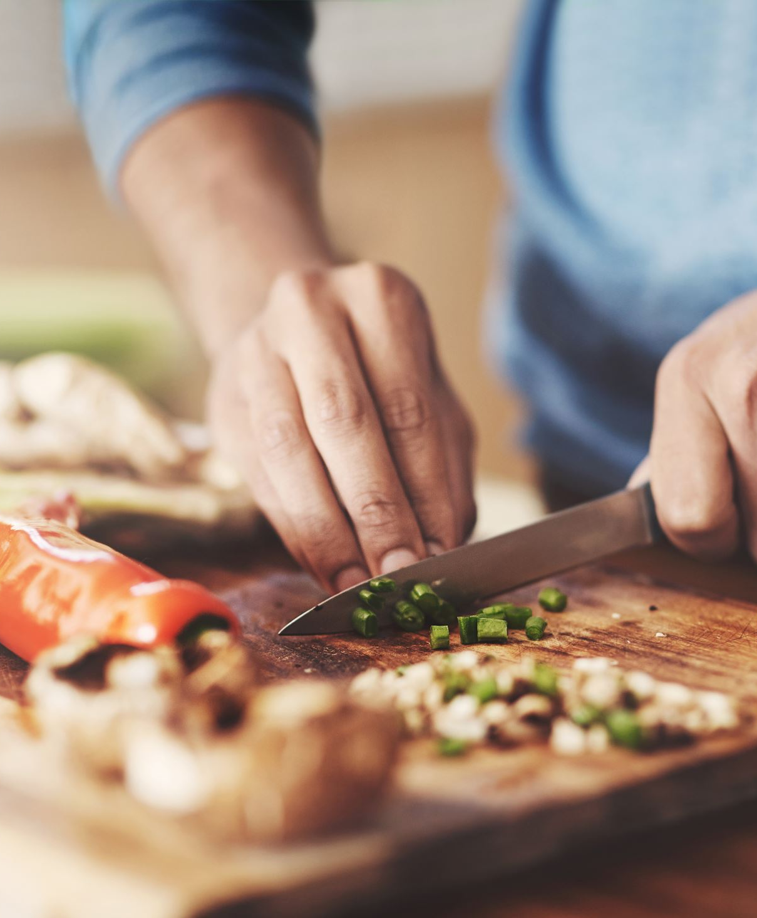
Problem Statement
It is challenging for individuals to monitor daily foods since it demands too much time and energy. Existing nutrition Apps ask you to input all the meals, ingredients, and quantity manually, and it might frustrate or dismay you. Also, for unpackaged food, such as that prepared at home, estimating the calories and nutrition is even more difficult. Unless there's a convenient automatic approach, people quickly abandon adherence to diet guidelines.

Slide 6
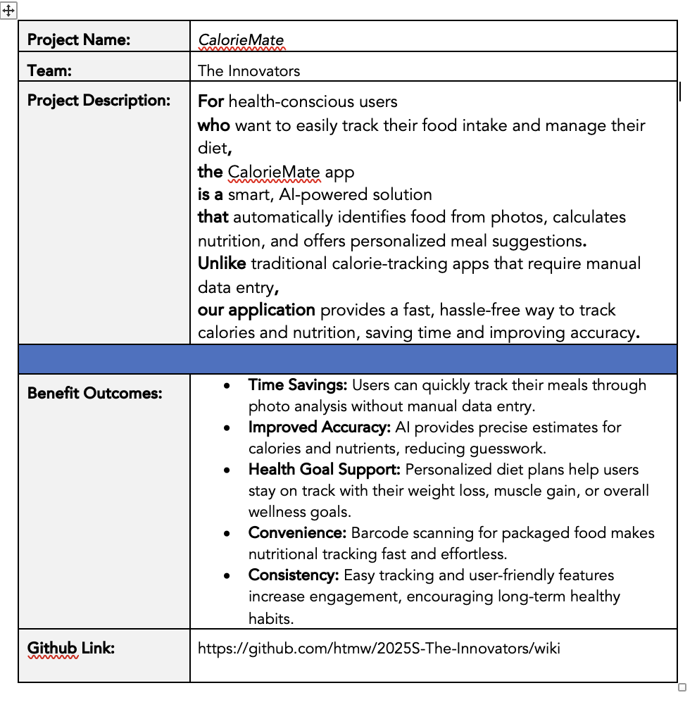
Project Description

Slide 7
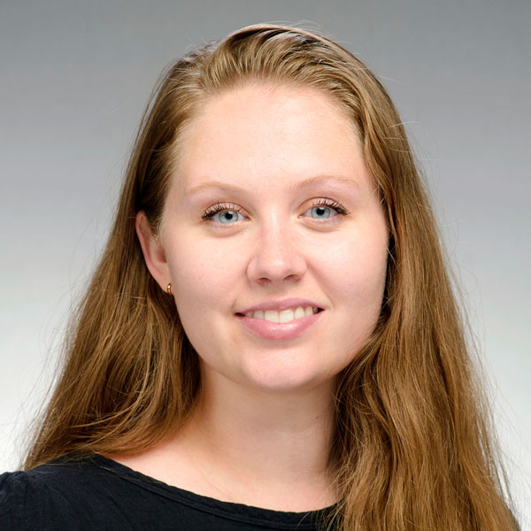
Persona
Emma Johnson (Fitness Freak)
Age: 28
Occupation: Marketing Specialist
Goals: To build muscle and maintain a healthy diet.
Challenges: Finds it time-consuming to manually log every meal and calculate macros (proteins, carbs, fats).
How CalorieMate Helps: Emily can take photos of her meals to instantly track nutrients, saving time and keeping her fitness plan on track.

Slide 8

Persona
John Cook (Busy Professional)
Age: 35
Occupation: Software Engineer
Goals: To lose weight and adopt healthier eating habits.
Challenges: Limited time to research or record calorie information due to his demanding work schedule.
How CalorieMate Helps: The app’s photo recognition and barcode scanner allow John to quickly track meals, making calorie management fit seamlessly into his day.

Slide 9

Persona
Kruti Patel (Health-Conscious Parent)
Age: 42
Occupation: Teacher
Goals: To maintain a balanced diet and teach her family healthy eating habits.
Challenges: Difficulties estimating nutritional content of home-cooked meals.
How CalorieMate Helps: Kruti can easily track home-cooked meals using photo recognition and adjust portions to get accurate nutritional insights, helping her plan meals for the entire family.

Slide 10

Technologies
Frontend: Expo (React Native)
Used to build the mobile app for both Android and iOS platforms, ensuring a smooth and consistent user experience across devices.

Slide 11



Technologies
Backend: FastAPI, MongoDB, AWS
FastAPI: Manages API communication between the mobile app, machine learning models, and database.
MongoDB: Stores user data such as meals, nutritional logs, and preferences.
AWS: Provides cloud infrastructure for hosting the app, including APIs, databases, and machine learning services, ensuring scalability and reliability.

Slide 12


Technologies
Machine Learning: PyTorch, Hugging Face
PyTorch: Used to build and deploy AI models for food recognition and nutrition estimation.
Hugging Face: Supplies pre-trained vision-language models (VLM) to improve image recognition accuracy, reducing development time.

Slide 13
Algorithm
Our application utilizes some important algorithms to automate and enhance the process of calorie and nutrition tracking. The food image recognition algorithm employs the InstructBLIP model to process meal images, identify food items, and recognize them with high accuracy. After recognizing the foods, a nutritional estimation algorithm estimates the calories, proteins, carbohydrates, and fats based on nutritional databases and approximate portion sizes.

Slide 14
Project Schedule
23 Jan. – 12 Feb.
Sprint 0
12 Feb. – 12 Mar.
Sprint 1
12 Mar. – 9 Apr.
Sprint 2
9 Apr–30 Apr.
Sprint 3

Slide 15
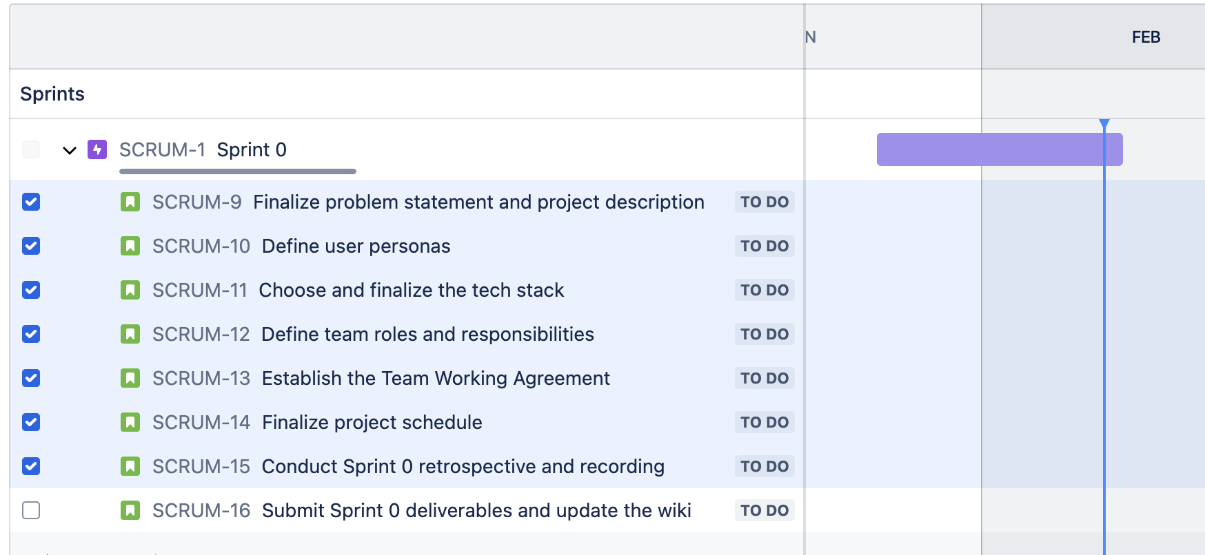
Project Schedule

Slide 16
Team Working Agreement
Communication: Lets make sure to share updates and have discussions on platforms like Slack. Make sure to have check ins, such, as weekly stand up meetings or sprint reviews to keep everyone on the same page and working together smoothly. Cooperation;
Collaboration: Let's help one another by exchanging information and resources while offering feedback and support to each other. Remember to honor the deadlines and give the team a heads up as soon as any delays or obstacles pop up.
Roles and Responsibilities: Each team member has the task of finishing assignments based on their designated roles in frontend development, backend development, and machine learning. Coordinate with teams to seamlessly incorporate various functionalities.
Decision-Making: Decisions will be collaboratively reached in team gatherings. In situations where there are differences in opinions or views arise among us team members, we go for majority votes.
Deliverables: Each sprint should lead to producing the outcomes like presentations updates, to technical papers and wikis. Make sure to review and test all your work before submitting it for consideration.
Retrospectives: After each sprint is completed it's important to have a session to review the successes and areas for improvement as well as to outline specific steps, for the upcoming sprint.
Agreed by:
Ranjitha Durgasi
Nikhitha Reddy Nallanagula
Harshitha Korapati Murali
Sai Bhargav Ram Koduru
Saikumar Gone
Kariveda Vikranth Reddy

Slide 17
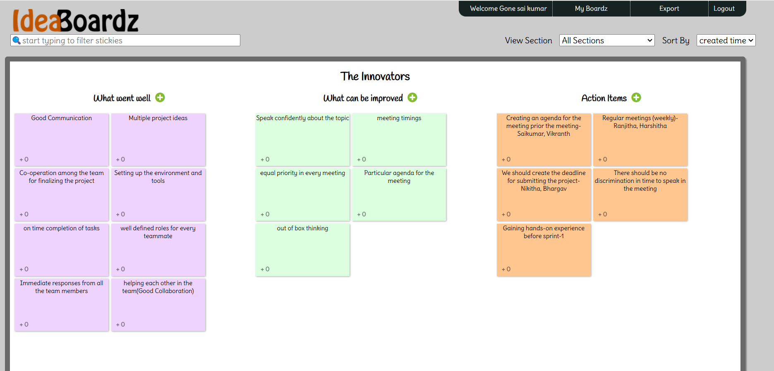
Retrospective

Slide 18
Wikipage Link
https://github.com/htmw/2025S-The-Innovators/wiki

